Slide 1

DETECTION AND CLASSIFICATION OF BRAIN TUMOR USING DEEP LEARNING
SREEJAN CHATTOPADHYAY 19BCE1541
ISHITA KUMAR 19BCE1551
DEVANG PATHAK 19BCE1559

Slide 2
ABSTRACT
Brain tumors are one of the leading reasons for deaths in adults and children. It is a deadly form of cancer that spreads really fast and is cause by uncontrollable brain cell growth. Tumors are dense and heterogeneous which makes it difficult to classify them.
Convolutional neural networks (CNNs) are most widely used machine learning algorithm for brain tumor recognition. This project proposed a CNN-based MobileNet Model. The dataset used contains two different collections. First collection contains 155 Brain MRI images that are tumorous and the second collection contains 98 Brain MRI images that are non-tumorous.

Slide 3
INTRODUCTION
The brain is the most complex organs to study. Today, one of the leading causes of untimely adult and children death is brain tumors. Almost, 150 kinds of brain tumors can be seen in humans. Two primary types are: 1) Benign tumors
2) Malignant tumors
Benign tumors spreads within the brain. Whereas, malignant tumors are called as brain cancer since they can also spread outside the confines of brain region. Early detection and true grading makes all the difference when it comes to brain tumors and saving someone’s life. Since, the brain tumors are dense, manual technique is less effective. Thus, a computer based detection method would prove to be beneficial and vital in resolving manual inaccuracies and saving an individual’s life. Recent developments in deep neural network modelling have resulted in newer techniques for the study, segmentation and classification of brain tumors.

Slide 4
Even with the development in deep learning techniques, brain tumor detection and classification methods are thriving for achieving higher accuracy due to vagueness in the domain.
The objective of the project is to designate a CNN Model for multi-classification of brain tumors using dataset available. We have proposed the usage of MobileNet model for our tumor classification.

Slide 5
LITERATURE REVIEW

Slide 6
Paper 1: Multimodal Brain Tumor Classification Using Deep Learning and Robust Feature Selection: A Machine Learning Application for Radiologists
The authors of this paper have proposed an automated multimodal classification method using deep learning for brain tumor type classification. The model works as follows:
1) Using edge-based histogram equalization and discrete cosine transformation(DCT) the linear contrast stretching is done.
2) The deep learning extraction is done. VGG16 and VGG19 CNN models were used for feature extraction.
3) A correntropy-based joint learning approach is implemented along with the extreme learning machine(ELM) for the selection of best features.
4) Partial least square(PLS)- based robust covariant features were fused in one matrix.
5) The combined matrix is fed to ELM for the final classification.
The proposed method had an accuracy of 97.8%, 96.9%, 92.5% for BraTs2015, BraTs2017, and BraTs2018, respectively, was achieved.

Slide 7
Paper 2: Multi-Classification of Brain Tumor Images Using Deep Neural Network
In this paper, a deep learning model based on CNN is proposed to analyze different brain tumor types using two available datasets. The first one differentiates tumors into meningioma, glioma, and pituitary tumor while the other one differentiates between the three glioma grades: Grades II, Grade III, Grade IV. The proposed structure has an accuracy of 96.13% and 98.7%, respectively, for the two studies.
The system, loads and extracts the images from datasets and starts preprocessing and augmentation techniques just after splitting the dataset into training, validation, and test sets. Then the training and validation set is run through the proposed network, followed by setting the hyper-parameters, regularization techniques, and optimization algorithm. Finally, network training and performance computations are presented. It includes 16 layers starting from the input layer which hold the augmented images from the previous pre-processing step passing through the convolution layers and their activation functions that are used in features selection and down-sampling (convolution, Rectified Linear Unit (ReLU), normalization, and pooling layers). To prevent overfitting, a dropout layer is used and followed by, a fully connected layer and a softmax layer to predict the output, and finally a classification layer that produces the predicted class.

Slide 8
Paper 3:Multi-grade brain tumor classification using deep CNN with extensive data augmentation
In this papers, the authors have proposed a novel convolutional neural network(CNN) based multi-grade brain tumor classification system.
The project works as follows:
1) Using a deep learning technique, tumor regions from an MRI are segmented.
2) Extensive data augmentation is employed to effectivly train the proposed system, avoiding the lack of data problem when dealing with MRI for multi-grade brain tumor classification.
3) A pre-trained CNN model is fine-tuned using augmented data for brain tumor grade classification.

Slide 9
Paper 4: A Deep Learning Model Based on Concatenation Approach for the Diagnosis of Brain Tumor
This paper proposes a method od multi-level features extraction and concentration for early diagnosis of brain tumor. With the help of Inception-v3 and DensNet201 models, the brain tumor detection has been done in two ways:
1) The features from pre-trained Inception-V3 model are extracted and are joined together for brain tumor classification. Then, theses concatenated features are passed to softmax classifier to classify the brain tumor.
2) Features are extracted from blocks from pre-trained DensNet201. These features are concatenated and passed to softmax classfier to classify the brain tumor.
On evaluating both the scenarios, the system gave an accuracy of 99.34% with Inception-V3 and 99.51% with DensNet201.

Slide 10
Paper 5: Brain Tumor Detection Using Deep Neural Network and Machine Learning Algorithm
The authors of this paper have proposed a solution that uses a CNN to detect tumor through brain MRI images. Images were first applied to the CNN. The accuracy of Softmax Fully Connected layer used to classify images obtained 98.67%. In addition to the accuracy criterion, they have used the benchmarks of Sensitivity, Specificity and Precision evaluate network performance. Also, the accuracy of the CNN is obtained with the Radial Basis Function (RBF) classifier 97.34% and the Decision Tree (DT) classifier, is 94.24%.
The new method is based on the combination of feature extraction techniques with the CNN for tumor detection from brain images. The method proposed accuracy 99.12% on the test data.

Slide 11
PROPOSED MODEL
In this project, we have used MobileNet model. MobileNet uses depthwise seperable convolutions.
It decreases the number of parameters when compared to other networks with same depth in nets. Therefore, it’s a very lightweight neural network.
Depthwise seperable convolution consists of two operations:
Depthwise Convolution – Filtering stage
Pointwise Convolution - Combining stage
Depthwise Seperable Convolution: This convolution was developed from the basis that a filter’s depth and its spatial dimension can be segregated- thus the naming.

Slide 12
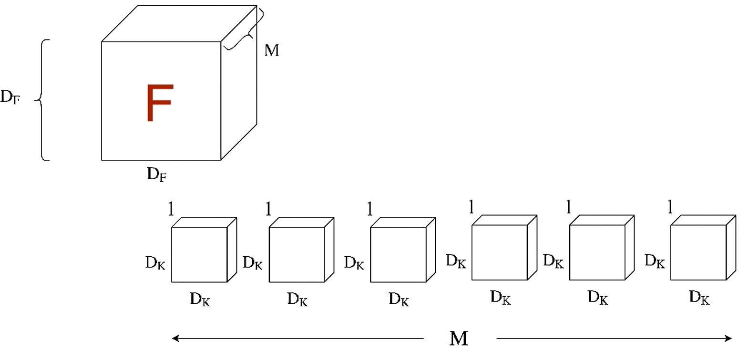
The basic idea is that this convolution considerably reduces the number of parameters to output the same number of channels.
Depth wise separable convolution is a depth wise convolution operation followed by a pointwise convolution operation.
Depth wise Convolution applies convolution to a single input channel at a time different from a standard convolution that applies over all channels.
Let’s say if we have a input volume F. F has a shape Df x Df x M where Df is the height and width of the input volume and M is the number of input channel.
For depth wise convolution we use filters or kernels K of shape Dk x Dk x 1 where Dk is the height and width of the kernel and depth is 1.
Since this kernel is convolved only on a single input channel we need M such kernels over the entire input volume F.

Slide 13
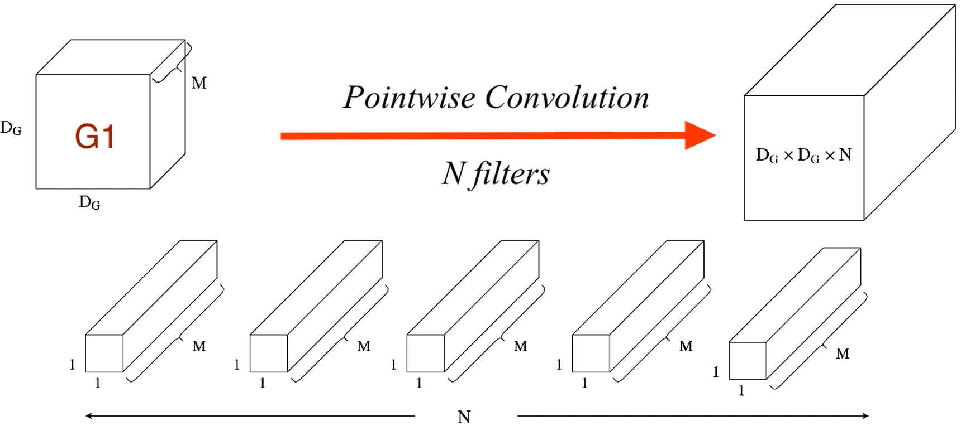
For all these M convolutions we end up with an output DG X DG X 1. Stacking these outputs together we have an output volume of G which is of shape DG X DG X M. This marks the end of depth wise convolution.
Point wise convolution: This involves performing linear combination of each of the layers. Here the input is a volume DG X DG X M. The filter here has a shape 1 x 1 x M.
This is basically a 1X1 operation over all the layers. The output will thus have same input width and height. Suppose we want to use N such filters then the output volume becomes
DG X DG X N.
So, we find that MobileNet Depth wise conv. Reduces computation time and parameters.

Slide 14
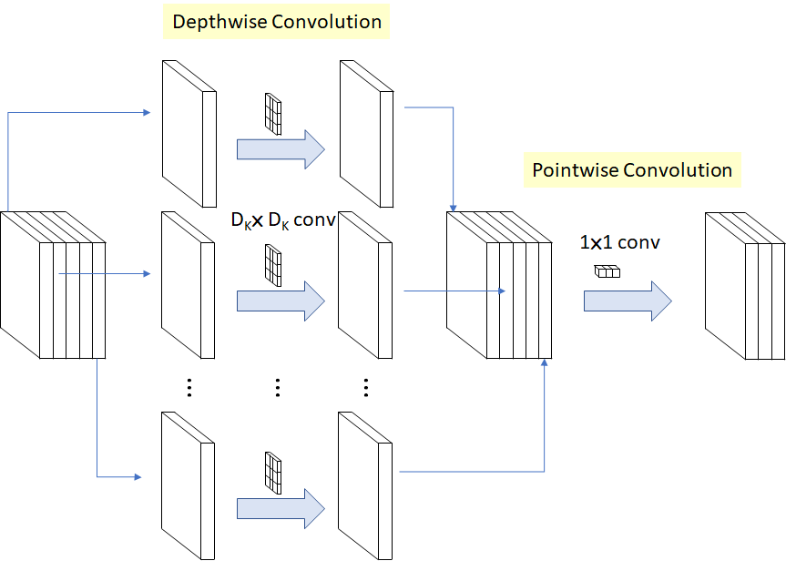

Slide 15
MobileNet function
tf.keras.applications.MobileNet(
input_shape=None,
alpha=1.0,
depth_multiplier=1,
dropout=0.001,
include_top=True,
weights="imagenet",
input_tensor=None,
pooling=None,
classes=1000,
classifier_activation="softmax",
**kwargs
)

Slide 16
CHALLENGES WITH DATASET
The dataset we found most suitable was a public dataset available on Kaggle- BRAIN MRI IMAGES FOR BRAIN TUMOR DETECTION
About the dataset: The dataset contains two separate files/collection of data. First file contains 155 Brain MRI Images that are tumorous and the other collection contains 98 Brain MRI images that are non-tumorous.
Image put into the model was of dimension 224 x 224
Challenge: The biggest challenge was that running a neural network needs large datasets for better results but our dataset is limited. And further we will divide it in 80% for training and leftover for testing and validation purposes.

Slide 17
NEED FOR DATA AUGMENTATION AND PREPROCESSING
So, as described in the previous slide. We needed larger dataset. This calls for data augmentation to format images and create different versions of similar content in order to expose the model to a wider range array of training examples. We applied the following for data requirements:
1. Rotation with range 10.
2. Width shift with range 0.1
3. Shear with range 0.1
4. Brightness was set with range 0.3 to 1.0
5. Horizontal flip and vertical flip was also performed.
6. Fill mode set to nearest.

Slide 18
Image preprocessing becomes important as it will decrease the model training time and increase model inference speed.
1. Crop the part of the image that contains only the brain ( most relevant and important part of the study)
2. Resize the image to a dimension of 224 X 224 X 3 because images in the dataset comes in different sizes.

Slide 19
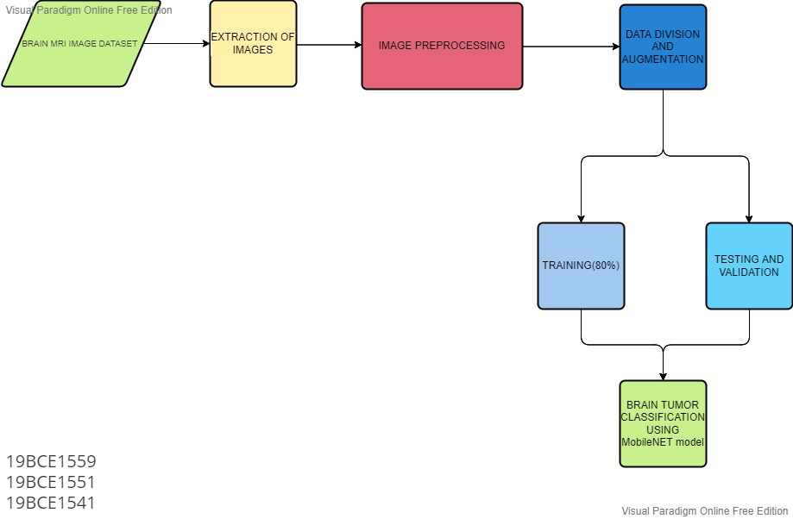
PROJECT OVERVIEW

Slide 20
REFERENCES
https://ieeexplore.ieee.org/abstract/document/8723045/
https://www.mdpi.com/791322
https://analyticalsciencejournals.onlinelibrary.wiley.com/doi/abs/10.1002/jemt.23597
https://www.sciencedirect.com/science/article/pii/S1877750318307385
https://ieeexplore.ieee.org/abstract/document/9025004/
https://www.sciencedirect.com/science/article/pii/S1389041719304735
https://ieeexplore.ieee.org/abstract/document/8964846/
https://www.sciencedirect.com/science/article/pii/S0010482519302148
https://ieeexplore.ieee.org/abstract/document/9129779/

Slide 21
https://www.ijirase.com/assets/paper/issue_1/volume_3/V3-Issue-2-458-465.pdf
https://onlinelibrary.wiley.com/doi/pdf/10.1002/jemt.23238
https://link.springer.com/article/10.1007/s00034-019-01246-3
https://www.mdpi.com/647760
https://www.sciencedirect.com/science/article/pii/S0730725X18304302
https://www.sciencedirect.com/science/article/pii/S0895611118305937
https://www.mdpi.com/520828
https://www.sciencedirect.com/science/article/pii/S0933365719306177
https://analyticalsciencejournals.onlinelibrary.wiley.com/doi/abs/10.1002/jemt.23281

Slide 22
https://link.springer.com/article/10.1007/s10916-019-1223-7
https://www.sciencedirect.com/science/article/pii/S0306987719313416
https://www.sciencedirect.com/science/article/pii/S016786551730404X
https://ieeexplore.ieee.org/abstract/document/8664160/
https://www.sciencedirect.com/science/article/pii/S016786551930340X

Slide 23
Your best quote that reflects your approach… “It’s one small step for man, one giant leap for mankind.”
- Neil Armstrong

